Slide 1
SOLID principles
Halyna Melnyk

Slide 2
OR How to get from here to there?
Example App: Before And After
IMessageInfo
Retriever
IEmailSender
Email Sending App
EmailProcessingService
Flat File
Database
Database
Reader
Service
File
IMessage
Info
Retriever
XML File
IFileFormat Reader
FileReader
Service
EmailService
IEmail
Service
Before
After

Slide 3
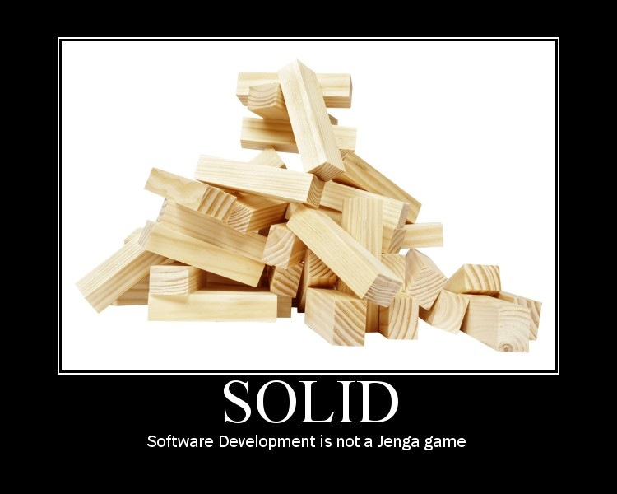

Slide 4
Object Oriented Principles - Quiz
Cohesion:
“A measure of how strongly-related and focused the various responsibilities of a software module are” - Wikipedia
Coupling:
“The degree to which each program module relies on each one of the other modules” – Wikipedia
Encapsulation:
“The hiding of design decisions in a computer program that are most likely to change” - Wikipedia

Slide 5
S.O.L.I.D. Principles
SRP: Single Responsibility Principle
OCP: Open Closed Principle
LSP: Liskov Substitution Principle
ISP: Interface Segregation Principle
DIP: Dependency Inversion Principle

Slide 6
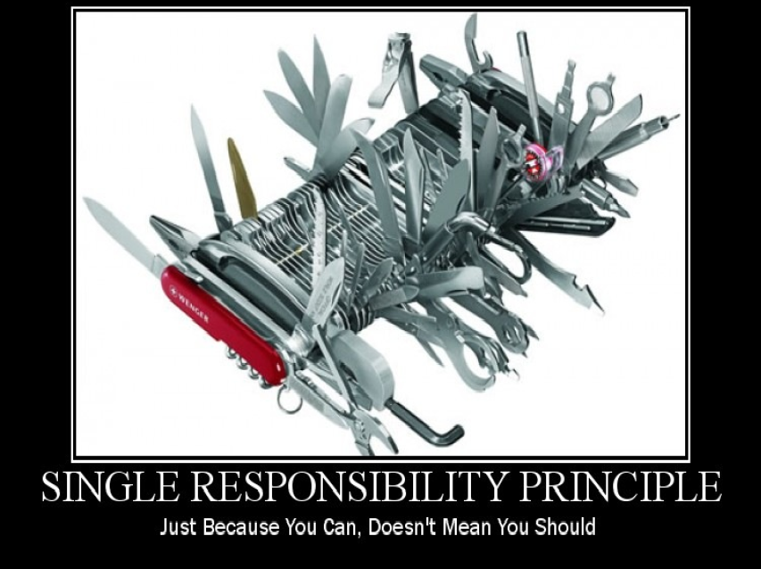

Slide 7
SRP: The Single Responsibility Principle
The Single Responsibility Principle states that every object should have a single responsibility, and that responsibility should be entirely encapsulated by the class.
Wikipedia
There should never be more than one reason for a class to change.
Robert C. “Uncle Bob” Martin

Slide 8
Cohesion and Coupling
Cohesion: how strongly-related and focused are the various responsibilities of a module
Coupling: the degree to which each program module relies on each one of the other modules
Strive for low coupling and high cohesion!

Slide 9
Responsibilities are Axes of Change
Requirements changes typically map to responsibilities
More responsibilities == More likelihood of change
Having multiple responsibilities within a class couples together these responsibilities
The more classes a change affects, the more likely the change will introduce errors.

Slide 10
What is a Responsibility?
“a reason to change”
A difference in usage scenarios from the client’s perspective
Multiple small interfaces (follow ISP) can help to achieve SRP

Slide 11
SRP: Single Responsibility
Email Sender
Email Sending App
Example App New Requirements: Send From Non-WinForms App. Read XML Or Flat File
Format Reader
File
Email Sending App
Flat File
XML File
Example App: Read A Flat File And Send An Email
Email Sender
Example App: A Better Structure
Flat File
XML File

Slide 12
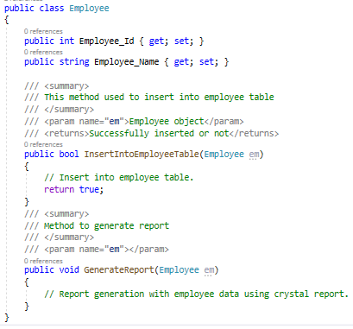
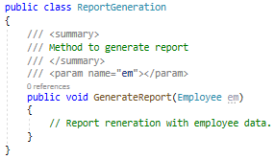
Notes:
Employee’ class is taking 2 responsibilities, one is to take responsibility of employee database operation and another one is to generate employee report. Employee class should not take the report generation responsibility because suppose some days after your customer asked you to give a facility to generate the report in Excel or any other reporting format, then this class will need to be changed and that is not good.
So according to SRP, one class should take one responsibility so we should write one different class for report generation, so that any change in report generation should not affect the ‘Employee’ class.

Slide 13
Summary
Following SRP leads to lower coupling and higher cohesion
Many small classes with distinct responsibilities result in a more flexible design
Related Fundamentals:
Open/Closed Principle
Interface Segregation Principle
Separation of Concerns
Recommended Reading:
Clean Code by Robert C. Martin [http://amzn.to/Clean-Code]

Slide 14
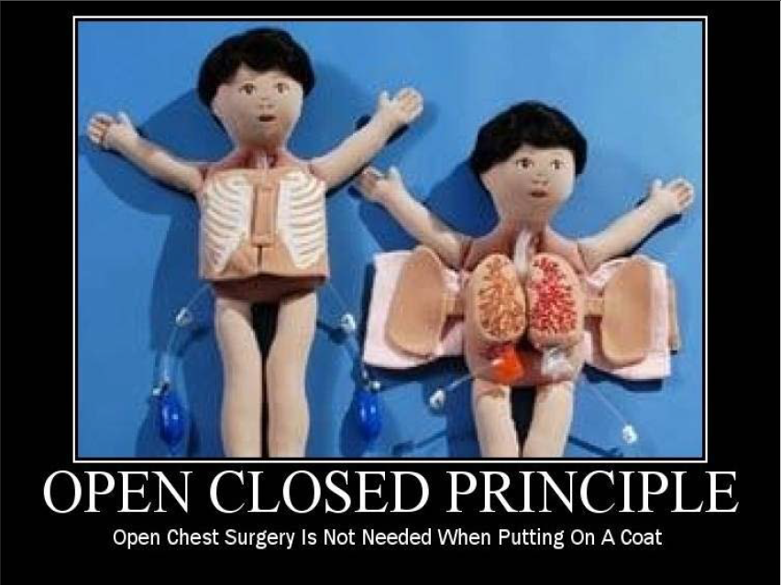

Slide 15
OCP: The Open/Closed Principle
The Open / Closed Principle states that software entities (classes, modules, functions, etc.) should be open for extension, but closed for modification
Wikipedia

Slide 16
The Open / Closed Principle
Open to Extension
New behavior can be added in the future
Closed to Modification
Changes to source or binary code are not required
Dr. Bertrand Meyer originated the OCP term in his 1988 book, Object Oriented Software Construction

Slide 17
Change behavior without changing code?
Rely on abstractions
No limit to variety of implementations of each abstraction
In .NET, abstractions include:
Interfaces
Abstract Base Classes
In procedural code, some level of OCP can be achieved via parameters

Slide 18
The Problem
Adding new rules require changes to the calculator every time
Each change can introduce bugs and requires re-testing, etc.
We want to avoid introducing changes that cascade through many modules in our application
Writing new classes is less likely to introduce problems
Nothing depends on new classes (yet)
New classes have no legacy coupling to make them hard to design or test

Slide 19
Three Approaches to Achieve OCP
Parameters (Procedural Programming)
Allow client to control behavior specifics via a parameter
Combined with delegates/lambda, can be very powerful approach
Inheritance / Template Method Pattern
Child types override behavior of a base class (or interface)
Composition / Strategy Pattern
Client code depends on abstraction
Provides a “plug in” model
Implementations utilize Inheritance; Client utilizes Composition

Slide 20
When do we apply OCP?
Experience Tells You
If you know from your own experience in the problem domain that a particular class of change is likely to recur, you can apply OCP up front in your design
Otherwise – “Fool me once, shame on you; fool me twice, shame on me”
Don’t apply OCP at first
If the module changes once, accept it.
If it changes a second time, refactor to achieve OCP
Remember TANSTAAFL
There Ain’t No Such Thing As A Free Lunch
OCP adds complexity to design
No design can be closed against all changes

Slide 21
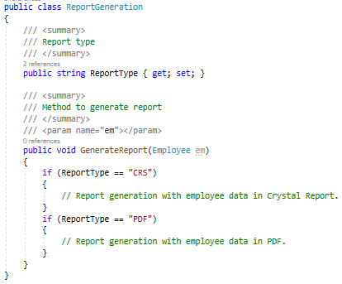
Notes:
Now take the same ‘ReportGeneration’ class as an example of this principle. Can you guess what is the problem with the below class!!
Brilliant!! Yes you are right, too much ‘If’ clauses are there and if we want to introduce another new report type like ‘Excel’, then you need to write another ‘if’. This class should be open for extension but closed for modification. But how to do that!!

Slide 22
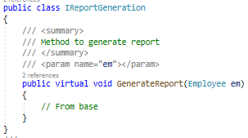
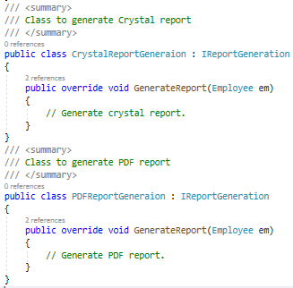
Notes:
So if you want to introduce a new report type, then just inherit from IReportGeneration. So IReportGeneration is open for extension but closed for modification.

Slide 23
Summary
Conformance to OCP yields flexibility, reusability, and maintainability
Know which changes to guard against, and resist premature abstraction
Related Fundamentals:
Single Responsibility Principle
Strategy Pattern
Template Method Pattern
Recommended Reading:
Agile Principles, Patterns, and Practices by Robert C. Martin and Micah Martin [http://amzn.to/agilepppcsharp]

Slide 24
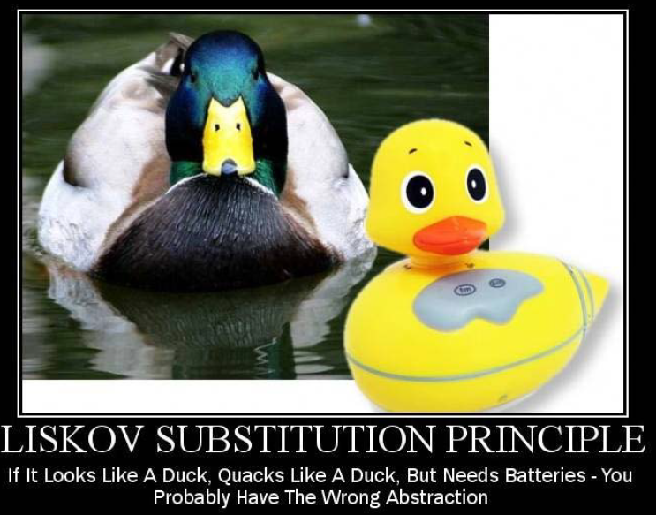

Slide 25
LSP: The Liskov Substitution Principle
The Liskov Substitution Principle states that Subtypes must be substitutable for their base types.
Agile Principles, Patterns, and Practices in C#
Named for Barbara Liskov, who first described the principle in 1988.

Slide 26
Substitutability
Child classes must not:
Remove base class behavior
Violate base class invariants
And in general must not require calling code to know they are different from their base type.
OOP teaches use of IS-A to describe child classes’ relationship to base classes
LSP suggests that IS-A should be replaced with
IS-SUBSTITUTABLE-FOR

Slide 27
LSP: Liskov Substitution Principle
Example App: Correcting For LSP – Move The Database Reader
Database
FileReader
Service
Email Sender
Database
Database
Reader
Service
IFileFormat Reader
Flat File
Email Sender
IFileFormat Reader
FileReader
Service
Flat File
XML File
Database Connection File
XML File
Example App: Violating LSP with Database Connection Info

Slide 28
The Problem
Non-substitutable code breaks polymorphism
Client code expects child classes to work in place of their base classes
“Fixing” substitutability problems by adding if-then or switch statements quickly becomes a maintenance nightmare (and violates OCP)

Slide 29
LSP Tips
“Tell, Don’t Ask”
Don’t interrogate objects for their internals – move behavior to the object
Tell the object what you want it to do
Consider Refactoring to a new Base Class
Given two classes that share a lot of behavior but are not substitutable…
Create a third class that both can derive from
Ensure substitutability is retained between each class and the new base
When do we fix LSP?
If you notice obvious smells like those shown
If you find yourself being bitten by the OCP violations LSP invariably causes

Slide 30
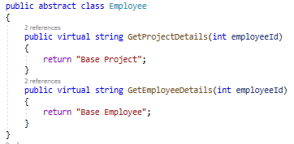
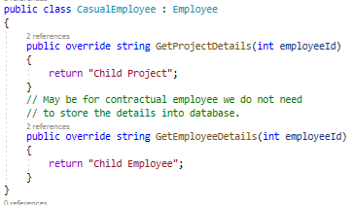
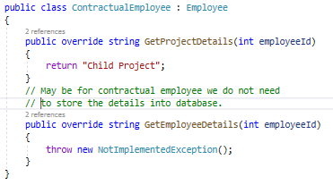
Employee
Casual Employee
Contractual Employee
Notes:
Now what is the meaning of this!! Ok let me take the same employee example to make you understand this principle. Check the below picture. Employee is a parent class and Casual and Contractual employee are the child classes, inhering from employee class.

Slide 31
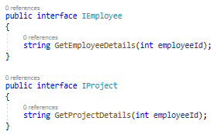
List<Employee> employeeList = new List<Employee>();
employeeList.Add(new ContractualEmployee());
employeeList.Add(new CasualEmployee());
foreach (Employee e in employeeList)
{
e.GetEmployeeDetails(1245);
}
Notes:
Up to this is fine right? Now, check the below code and it will violate the LSP principle.
Now I guess you got the problem. Yes right, for contractual employee, you will get not implemented exception and that is violating LSP. Then what is the solution? Break the whole thing in 2 different interfaces,
1. IProject
2. IEmployee and implement according to employee type.
Now, contractual employee will implement IEmployee not IProject. This will maintain this principle.

Slide 32
Summary
Conformance to LSP allows for proper use of polymorphism and produces more maintainable code
Remember IS-SUBSTITUTABLE-FOR instead of IS-A
Related Fundamentals:
Polymorphism
Inheritance
Interface Segregation Principle
Open / Closed Principle
Recommended Reading:
Agile Principles, Patterns, and Practices by Robert C. Martin and Micah Martin [http://amzn.to/agilepppcsharp]

Slide 33
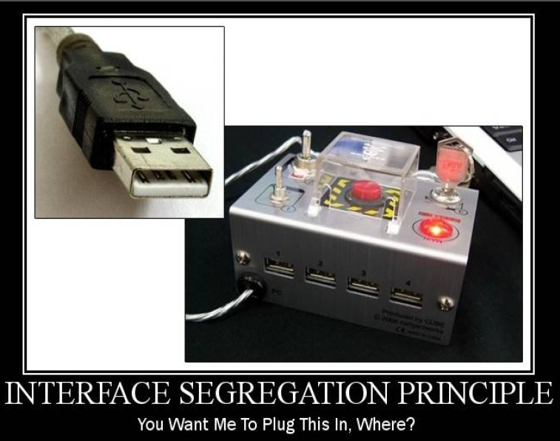

Slide 34
ISP: The Interface Segregation Principle
The Interface Segregation Principle states that Clients should not be forced to depend on methods they do not use.
Agile Principles, Patterns, and Practices in C#
Corollary:
Prefer small, cohesive interfaces to “fat” interfaces

Slide 35
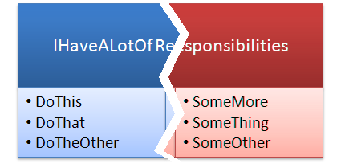
ISP: Interface Segregation Principle
“This principle deals with the disadvantages of ‘fat’ interfaces. Classes that have ‘fat’ interfaces are classes whose interfaces are not cohesive. In other words, the interfaces of the class can be broken up into groups of member functions. Each group serves a different set of clients. Thus some clients use one group of member functions, and other clients use the other groups.”
- Robert Martin

Slide 36
ISP: Interface Segregation Principle
Example App: Clarifying The Email Sender and Message Info Parsing
EmailSender
EmailSender
Database Reader
Service
SendEmail
ReadFile
ReadFromDb
SendEmail
GetMessageBody
FileReader
Service
GetMessageBody

Slide 37
The Problem
AboutPage simply needs ApplicationName and AuthorName
Forced to deal with huge ConfigurationSettings class
Forced to deal with actual configuration files
Interface Segregation violations result in classes that depend on things they do not need, increasing coupling and reducing flexibility and maintainability

Slide 38
ISP Tips
Keep interfaces small, cohesive, and focused
Whenever possible, let the client define the interface
Whenever possible, package the interface with the client
Alternately, package in a third assembly client and implementation both depend upon
Last resort: Package interfaces with their implementation
When do we fix ISP?
Once there is pain
If there is no pain, there’s no problem to address.
If you find yourself depending on a “fat” interface you own
Create a smaller interface with just what you need
Have the fat interface implement your new interface
Reference the new interface with your code
If you find “fat” interfaces are problematic but you do not own them
Create a smaller interface with just what you need
Implement this interface using an Adapter that implements the full interface

Slide 39

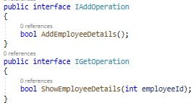

Notes:
Now what does this mean, suppose there is one database for storing data of all types of employees (i.e. Permanent, non-permanent), now what will be the best approach for our interface?
And all types of employee class will inherit this interface for saving data. This is fine right? Now suppose that company one day told to you that they want to read only data of permanent employees. What you will do, just add one method to this interface?
But now we are breaking something. We are forcing non-permanent employee class to show their details from database. So, the solution is to give this responsibility to another interface.
And non-permanent employee will implement only IAddOperation and permanent employee will implement both the interface.

Slide 40
Summary
Don’t force client code to depend on things it doesn’t need
Keep interfaces lean and focused
Refactor large interfaces so they inherit smaller interfaces
Related Fundamentals:
Polymorphism
Inheritance
Liskov Substitution Principle
Fasade Pattern
Recommended Reading:
Agile Principles, Patterns, and Practices by Robert C. Martin and Micah Martin [http://amzn.to/agilepppcsharp]

Slide 41
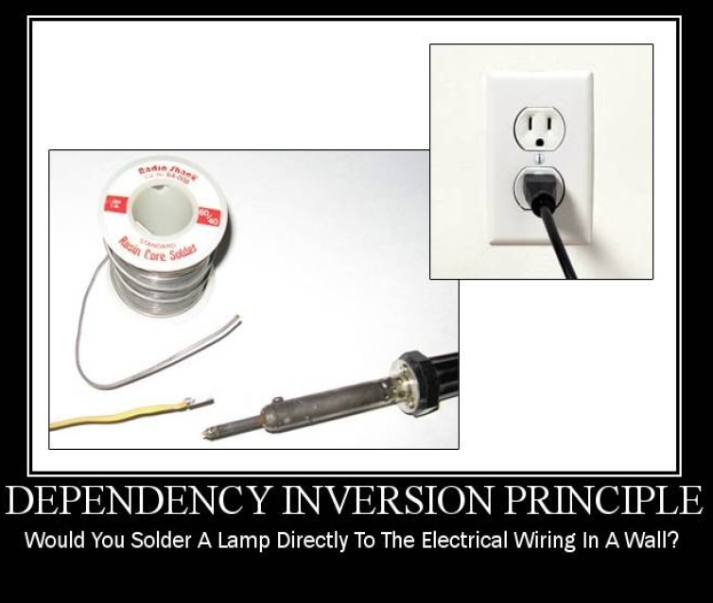
Notes:
This principle tells you not to write any tightly coupled code because that is a nightmare to maintain when the application is growing bigger and bigger. If a class depends on another class, then we need to change one class if something changes in that dependent class. We should always try to write loosely coupled class.

Slide 42
DIP: Dependency Inversion Principle
“What is it that makes a design rigid, fragile and immobile? It is the interdependence of the modules within that design. A design is rigid if it cannot be easily changed. Such rigidity is due to the fact that a single change to heavily interdependent software begins a cascade of changes in dependent modules.”
- Robert Martin
High-level modules should not depend on low-level modules. Both should depend on abstractions.
Abstractions should not depend on details. Details should depend on abstractions.
Agile Principles, Patterns, and Practices in C#
Dependency
Depender

Slide 43
DIP: Dependency Inversion Principle
ThisClass
ThatClass
IDoSomething
AnotherClass
IWhatever
ThisClass
ThatClass
IDoSomething
AnotherClass
IDoSomething
ThisClass
IWhatever
IWhatever
ThatClass
AnotherClass

Slide 44
DIP: Dependency Inversion Principle
AnotherClass
Xml File Reader
Flat File Reader
IWhatever
IWhatever
IFileFormat Reader
ThatClass
Database Reader Service
File Reader Service
Email Sender
IDoSomething
IDoSomething
IMessageInfoRetriever
IEmailService
ThisClass
ProcessingService

Slide 45
Traditional Programming and Dependencies
High Level Modules Call Low Level Modules
User Interface depends on
Business Logic depends on
Infrastructure
Utility
Data Access
Static methods are used for convenience or as Façade layers
Class instantiation / Call stack logic is scattered through all modules
Violation of Single Responsibility Principle

Slide 46
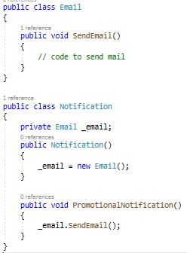
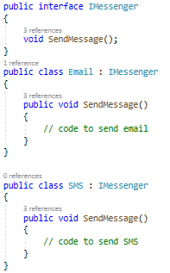
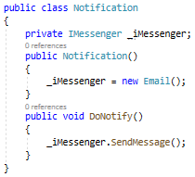
Notes:
Suppose there is one notification system after saving some details into database.
Now Notification class totally depends on Email class, because it only sends one type of notification. If we want to introduce any other like SMS then? We need to change the notification system also. And this is called tightly coupled. What can we do to make it loosely coupled? Ok, check the following implementation.
Still Notification class depends on Email class. Now, we can use dependency injection so that we can make it loosely coupled. There are 3 types to DI, Constructor injection, Property injection and method injection.

Slide 47
Dependency Injection
Dependency Injection is a technique that is used to allow calling code to inject the dependencies a class needs when it is instantiated.
The Hollywood Principle
“Don’t call us; we’ll call you”
Three Primary Techniques
Constructor Injection
Property Injection
Parameter Injection
Other methods exist as well

Slide 48
Constructor Injection
Dependencies are passed in via constructor
Strategy Pattern
Pros
Classes self-document what they need to perform their work
Works well with or without a container
Classes are always in a valid state once constructed
Cons
Constructors can have many parameters/dependencies (design smell)
Some features (e.g. Serialization) may require a default constructor
Some methods in the class may not require things other methods require (design smell)

Slide 49
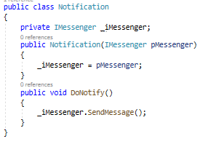
Constructor Injection

Slide 50
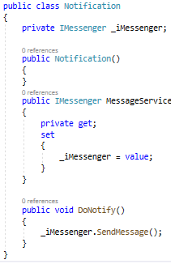
Property Injection
Dependencies are passed in via a property
Also known as “setter injection”
Pros
Dependency can be changed at any time during object lifetime
Very flexible
Cons
Objects may be in an invalid state between construction and setting of dependencies via setters
Less intuitive

Slide 51
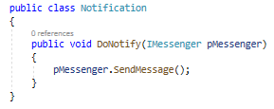
Parameter Injection
Dependencies are passed in via a method parameter
Pros
Most granular
Very flexible
Requires no change to rest of class
Cons
Breaks method signature
Can result in many parameters (design smell)
Consider if only one method has the dependency, otherwise prefer constructor injection

Slide 52
Summary
Depend on abstractions.
Don’t force high-level modules to depend on low-level modules through direct instantiation or static method calls
Declare class dependencies explicitly in their constructors
Inject dependencies via constructor, property, or parameter injection
Related Fundamentals:
Single Responsibility Principle
Interface Segregation Principle
Façade Pattern
Inversion of Control Containers
Recommended Reading:
Agile Principles, Patterns, and Practices by Robert C. Martin and Micah Martin [http://amzn.to/agilepppcsharp]
http://www.martinfowler.com/articles/injection.html

Slide 53
Dependency Injection
Dependency is transitive
If UI depends on BLL depends on DAL depends on Database Then *everything* depends on the Database
Depend on abstractions (DIP)
Package interfaces (abstractions) with the client (ISP)
Structure Solutions and Projects so Core / BLL is at center, with fewest dependencies

Slide 54
Summary
Don’t Depend on Infrastructure Assemblies from Core
Apply DIP to reverse dependencies
Related Fundamentals:
Open Closed Principle
Interface Segregation Principle
Strategy Pattern
Recommended Reading:
Agile Principles, Patterns, and Practices by Robert C. Martin and Micah Martin [http://amzn.to/agilepppcsharp]
http://www.martinfowler.com/articles/injection.html

Slide 55
S.O.L.I.D. Conversion Summary
Example App: Before And After
IMessageInfo
Retriever
IEmailSender
Email Sending App
EmailProcessingService
Flat File
Database
Database
Reader
Service
IMessage
Info
Retriever
File
XML File
IFileFormat Reader
FileReader
Service
EmailService
IEmail
Service
Before
After

Slide 56
Credits & References
Robert C Martin – Clean Coder https://sites.google.com/site/unclebobconsultingllc/
https://itnext.io/solid-principles-explanation-and-examples-715b975dcad4
https://www.c-sharpcorner.com/UploadFile/damubetha/solid-principles-in-C-Sharp/
https://medium.com/@mirzafarrukh13/solid-design-principles-c-de157c500425
http://pluralsight.com/training/Courses/TableOfContents/principles-oo-design
Marcin Zajączkowski - http://solidsoft.wordpress.com/
http://www.objectmentor.com/resources/articles/srp.pdf
http://stefanroock.files.wordpress.com/2011/09/solidforyourlanguage.pdf
Notes:
Out lines

Slide 57
Thank You!

